Slide 1

PRONTO
Joanna G. Escalon, MD
Lilin Wang, MENG
Gray R. Lyons, MD,PhD
Roger J. Bartolotta, MD
Apostolos J. Tsiouris, MD
George L. Shih, MD, MS
Open Source Webapp for Management of Imaging Protocols and Protocol Updates

Slide 2
Protocol management and standardization are crucial in radiology practices of all sizes.
Goals:
Ensure patient safety
Minimize radiation dose (CT)
Sustain highest quality imaging parameters
Maintain throughput
Promote timely and universal updates
Enable routine quality assurance

Slide 3
Implementing revised and/or new protocols can be cumbersome.
While some 3rd party vendor tools are available, many practices use standard documents or spreadsheets for management

Slide 4
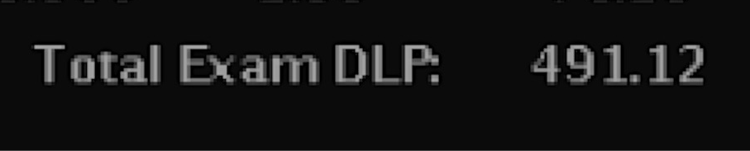
Every step relies on a chain of communication that is hard to track and can break down.
1. Problem Identified
2. Conference Held & Decision made
3. Decision Communicated
4. Tech or Physicist Changes Scanner Settings
5. Patient Care Improved

Slide 5
Decision to change a protocol may be made, but implementation may fail or is not confirmed.
1. Problem Identified
2. Conference Held & Decision made
3. Decision Communicated
4. Tech or Physicist Changes Scanner Settings
5. Patient Care Improved
How do you know the change was made?
Do you have a way to confirm the change with the lead technologist or modality chief?
Did all of the people who need to know about the change get notified?
Were all steps achieved in a timely manner?
Notes:
How do you know the change was made? Do you have a way to confirm with lead technologist or modality chief?

Slide 6

Without a way to confirm a protocol change, the problem will only be noticed when you see a suboptimal study.
Problem is re-assessed and changes are finally made
This doesn’t look right!
That’s better!

Slide 7
By introducing an automated system like PRONTO for tracking protocol changes, we can improve this process.
1. Problem Identified
2. Conference Held & Decision made
3. Decision Communicated
4. Tech or Physicist Changes Scanner Settings
5. Patient Care Improved
PRONTO is a solution to the pitfalls of protocol management.
Notes:
Note --- add --- Pronto doesn’t talk directly with the scanners; partially related to issues with access to computers of the scanners by vendors; some other people are trying to work on that; we weren’t trying to solve that probelm

Slide 8
What is PRONTO?
PRONTO is an open-source Protocol management web-app via which a Radiology Department can collect, modify and view protocols
It provides a free convenient web-based way to distribute protocols to physicians and technologists
It manages the process of protocol updates with email notifications to the appropriate individuals
It uses the LAMP stack (Linux, Apache, MySQL, PHP)
Notes:
- CRUD --- intentionally externalized create and update
- Stored on a server and the software stack is LAMP (Linux Apache MySQL PHP)
- Parts of software stack: operating system (Linux), webserver (software piece that talks to the browser, Apache is an HTTP server), database management system (MySQL), programing language (PHP)

Slide 9
How does PRONTO work?
A decision is made to change a protocol parameter
The division head or other radiologist assigned to managing that protocol downloads the protocol from PRONTO (in the form of an Excel spreadsheet), updates the spreadsheet and re-uploads it to PRONTO (CSV upload)
This spreadsheet replaces the prior spreadsheet and differences are registered by PRONTO
PRONTO sends email notifications to all assigned parties
Technologists and/or physicists reply with confirmation when scanner settings are changed
⬇
⬇
⬇
⬇

Slide 10
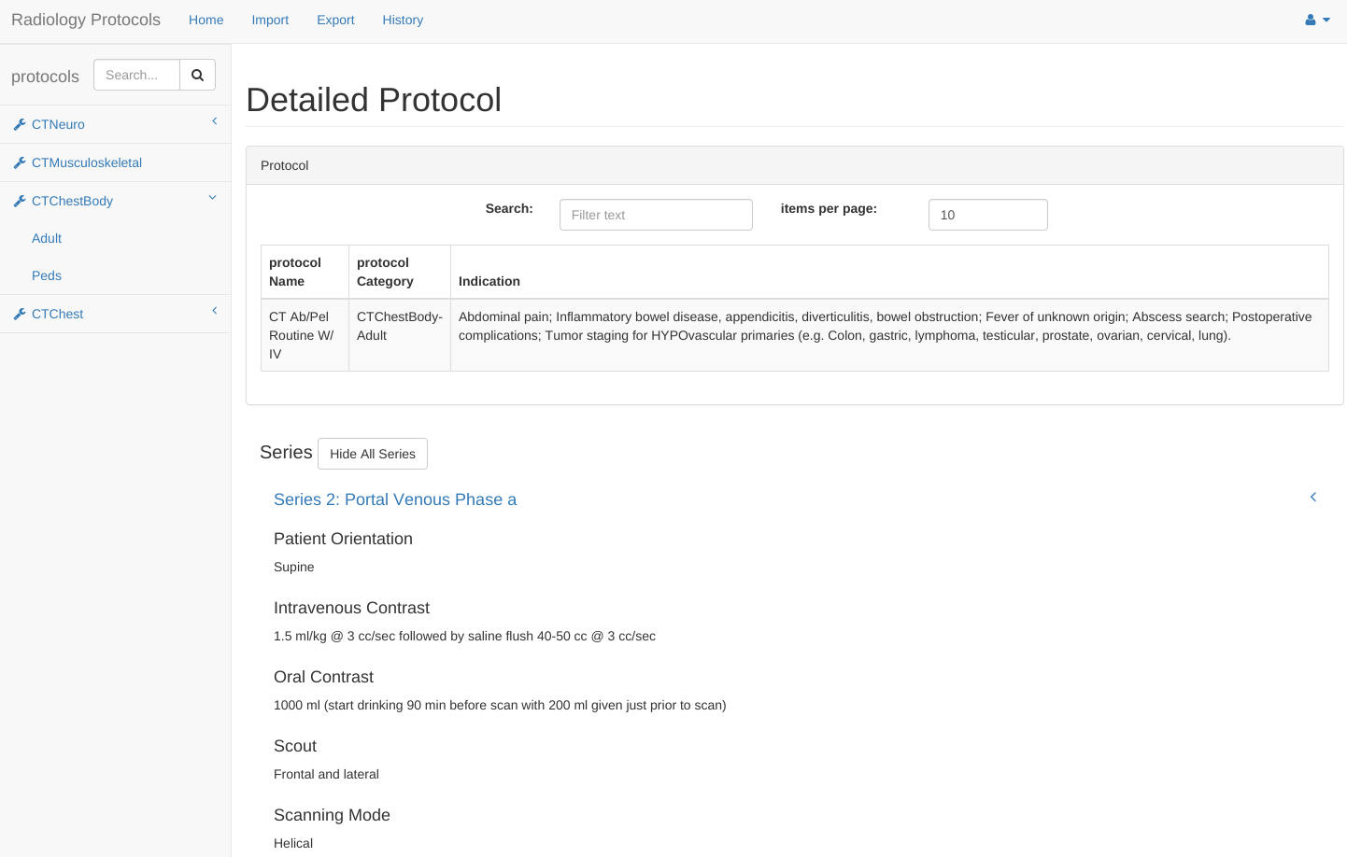
Step 1: Review Protocol & Decide on Change

Slide 11
Example Protocol: Pediatric CT Abdomen Pelvis with Contrast
Additional included parameters (most of which are weight-based):
- Slice Thickness
- Interval
- Pitch
- kVp
- mA
- Noise Index
- Noise Reduction
- Rotation Time
- Scan FOV
- Display FOV
- Scan Delay
- Post Processing
- Transfer Images
- CTDI maximums

Slide 12
Example Protocol: Adult Chest CT - Pulmonary Embolism

Slide 13
Step 2: Download Excel and Update
Each row is a series
Each column is a protocol parameter

Slide 14
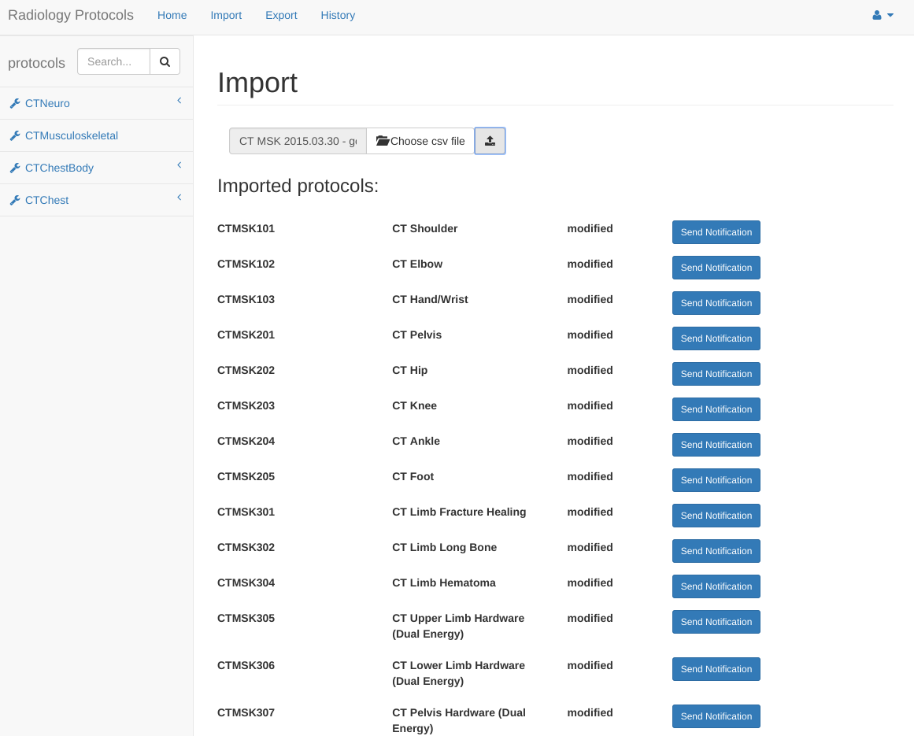
Step 3: Re-upload Excel as a CSV file
CSV Upload

Slide 15
Step 4: Notify Others of Change
Send Notification after Modification

Slide 16
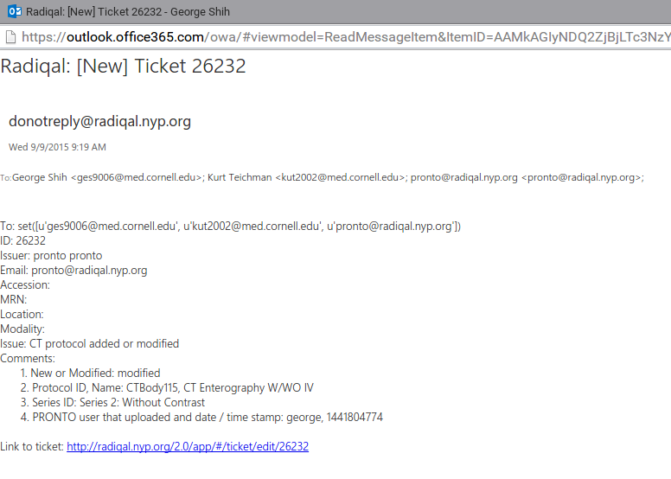
Step 5: Notification Emailed
& Recipients Confirm Change
Email indicates which protocol was changed, which series, and who made the change

Slide 17
Other Advantages of PRONTO
A search box allows protocols to be located by name and/or indication, which may be helpful for residents and technologists during the protocoling process
Each protocol also has a unique URL that can be easily shared
Protocols can be easily exported and backed up with a single click

Slide 18
Example Search: “Mesenteric Ischemia”
Type term in search box
Relevant protocols are shown

Slide 19
Our Experience So Far & Future Plans
We have already uploaded our CT protocols for all subspecialties (total of 162 protocols)
We are in the process of uploading our MR protocols
PRONTO lists all protocol parameters, which will allow us to better perform more comprehensive quality assurance
By crosschecking the protocol parameters with DICOM information and data from our ordering system, we can ensure that the correct study was performed with the correct protocol
Notes:
Future? ----- medacalis ordering + exact perameters from pronto + DICOM → instead of sampling QA/when notice errors, check if all of these match and we are truly following orders/protocols

Slide 20
Conclusion
PRONTO is a free open source web-based protocol management system
It provides a practical way to manage, update, and search imaging protocols, allowing a radiology practice to efficiently ensure high quality imaging
Source Code: http://src.pronto.trove.nyc
Notes:
Similar products:
https://www.radiologyprotocols.com/ ---- RP Radiology Product Suite
Bayer’s Radimetrics™ Enterprise Platform ---- merges and mobilizes patient dose histories and current exam details, bringing analysis and quality solutions to the point of care and enterprise-wide. The platform assists you in maintaining a revision-controlled repository for protocol management across the enterprise. Receive alerts when a DRL is breached, a new protocol is approved, or to advise users of a scheduled review.

